Slide 1
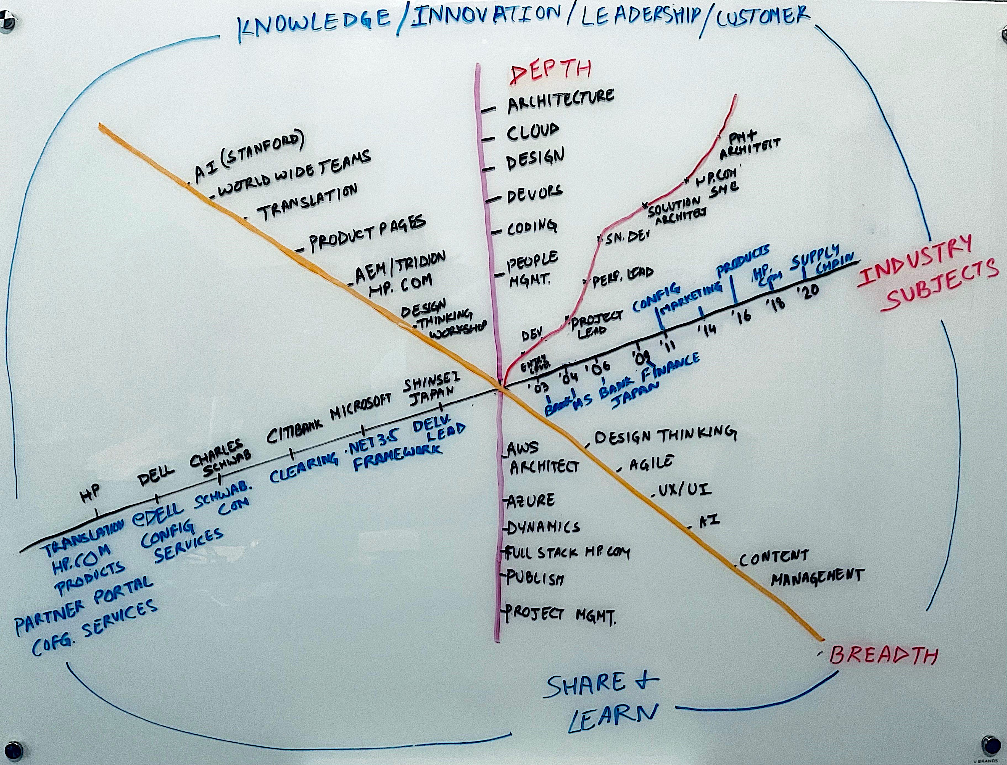
About Me
Engineering manager
My Virtual CV

Slide 2



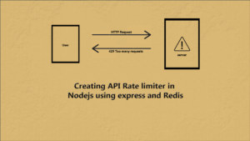

What I do
Get lot of requests and hold the right tasks to keep focus
Balance load based on people
Rate limit so best developer does not get burnt out
Monitors devs who are either struggling with tasks or reassigning or spinning new

Slide 3




Customer Journey-Fiji
Sales / Sales Ops
Supply Chain
CURRENT EXPERIENCE
Multiple disconnected tools required
Very long TAT to get a quote
SKU-based quotes require full factory setup
Disconnected manual tools slowing responsiveness
E2E TAT not measured
Sales/Sales Ops R&R and engagement process varies by region
Customer Interest
Solutioning and Hardware build configuration
Customer Requests quote
Config Services requirements gathering
SKU setup
& Costing
Engineering
Factory Pilot
SKU ready
to ORDER
Customer may not know exactly what they want – only that they want a quote
Tool not intuitive
Eclipse & Pricing
SKU-based quote ready to send
Customer waits 9-14 days for full factory setup
SC resources wasted if order never comes
Resource dependent, lacks scale for growth or automation
FUTURE EXPERIENCE
E2E TAT measurements
WW R&R alignment
25% TAT reduction for SC TAT
Decoupled quote and factory setup process
Sales engagement is clearly measured
Customer Interest
Solutioning and Hardware build configuration
Customer Requests quote
SKU-based quote ready to send
BEST IN CLASS factory setup time 5-8 days
New Everest scalable for growth and automation
Setup optionally continues as customer evaluates quote
Streamlined experience with comprehensive toolset
Config Services requirements gathering
SKU setup
& Costing
Engineering
Factory Pilot
SKU ready
to ORDER
Customer engaged when ready
Eclipse & Pricing

Slide 4
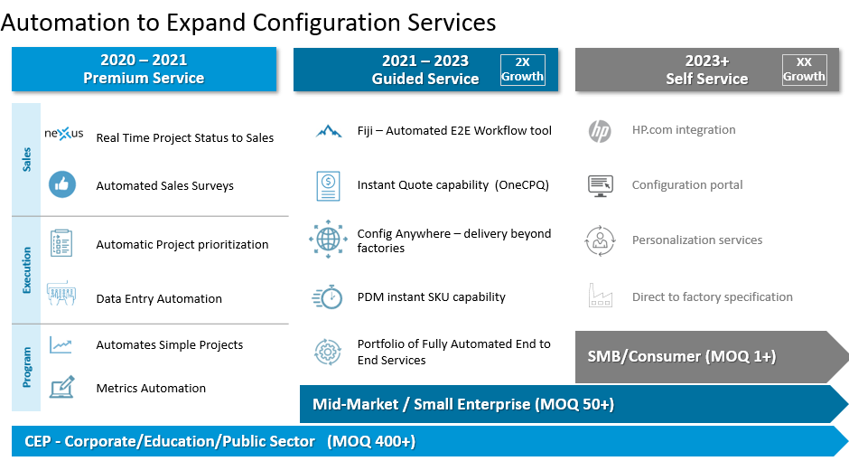

Slide 5
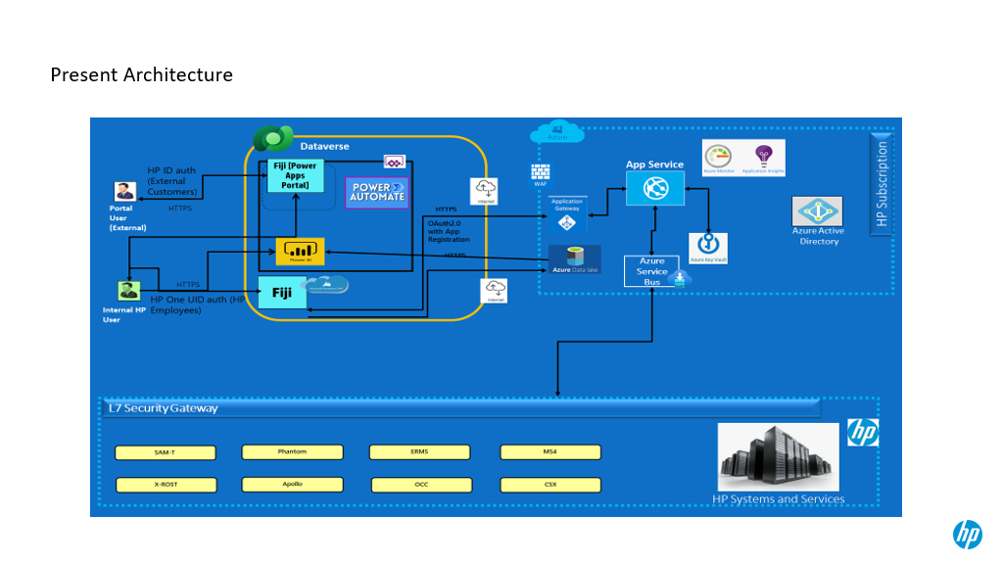
High-Level Design-Fiji

Slide 6
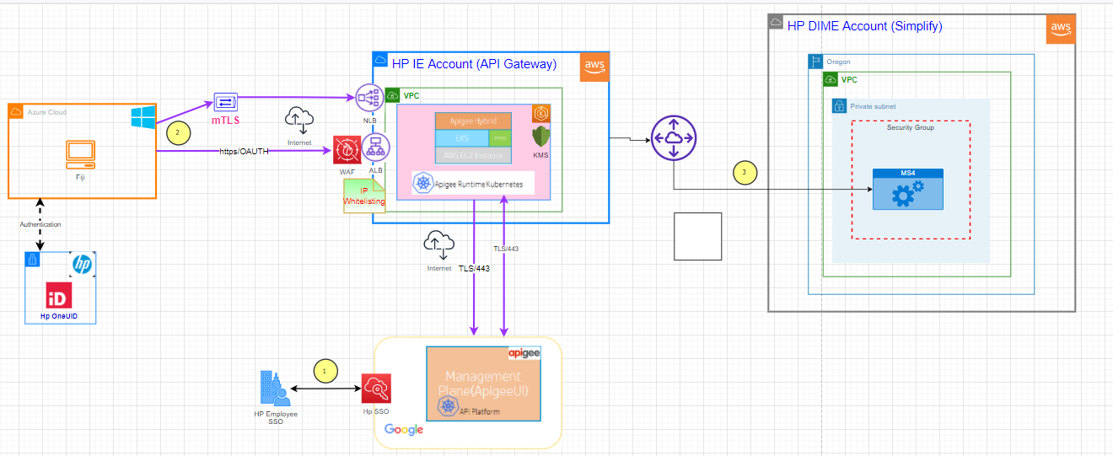
Integration Design-Fiji

Slide 7




























Eclipse- Deal and Discount Management System Architecture
HP Network
https://www.pricehub.hp.com
1
ReactJS UI – Using in memory DOM which makes it very fast and responsive – Web Based (vs Windows app) Easy to enable on mobile – cross platform support
Very fast rendering, responsive.
AWS Cloud
AWS Secrets Manager
API Gateway or
VPC
User Interface
Auto Scaling
One Hp Unified Id
Public/Private Subnets and
Availability zones as needed
Security token
2
6
UI components are deployed on S3 – scalable and HA storage
Serverless Architecture supports – Kubernetis for orchestration
SPA Web App
SPA Web App
Load Balancing
S3
Deal Manager
Pricing Decision Console
API Gateway
5
EKS
Fargate
SPA Web App
SPA Web App
gRPC – faster comm between services uses HTTP2 advanced
GraphQL – makes it easier to query APIs and reduces payload
Promotions
Workflow/Approval
Security token
CloudWatch
Auto Scaling
Other HP Services
Application Services
Shared Services
Amazon RDS (DXC initially)
Opportunity Lookup
Deal Services
Product Services
Identity Services
Certified” OpenId Connect (oidc) / oAuth2 Security Token Server (STS)
Primary
Standby
MDM Sales Territory
Margin Analysis Services
Pricing Decision
ezPRS BOM & Discount Services
C4Lookup
4
Microservices replaced
Legacy Eclipse Server which was a monolith. Now we can scale every service individually eg Deal Service can ba auto-scaled a new POD / VM will get started if Deal Services runs out of resources. Each service can be deployed individually simplifying releases
ElasticCache Redis
Optimus Services
Code quality
3
Lookup Services
(Product, Reseller, Customer)
Redis cache is a standalone distributed memory that automatically stores most frequently used data – low latency, high-throughput. Easy to scale up
Workflow/Quote Services

Slide 8
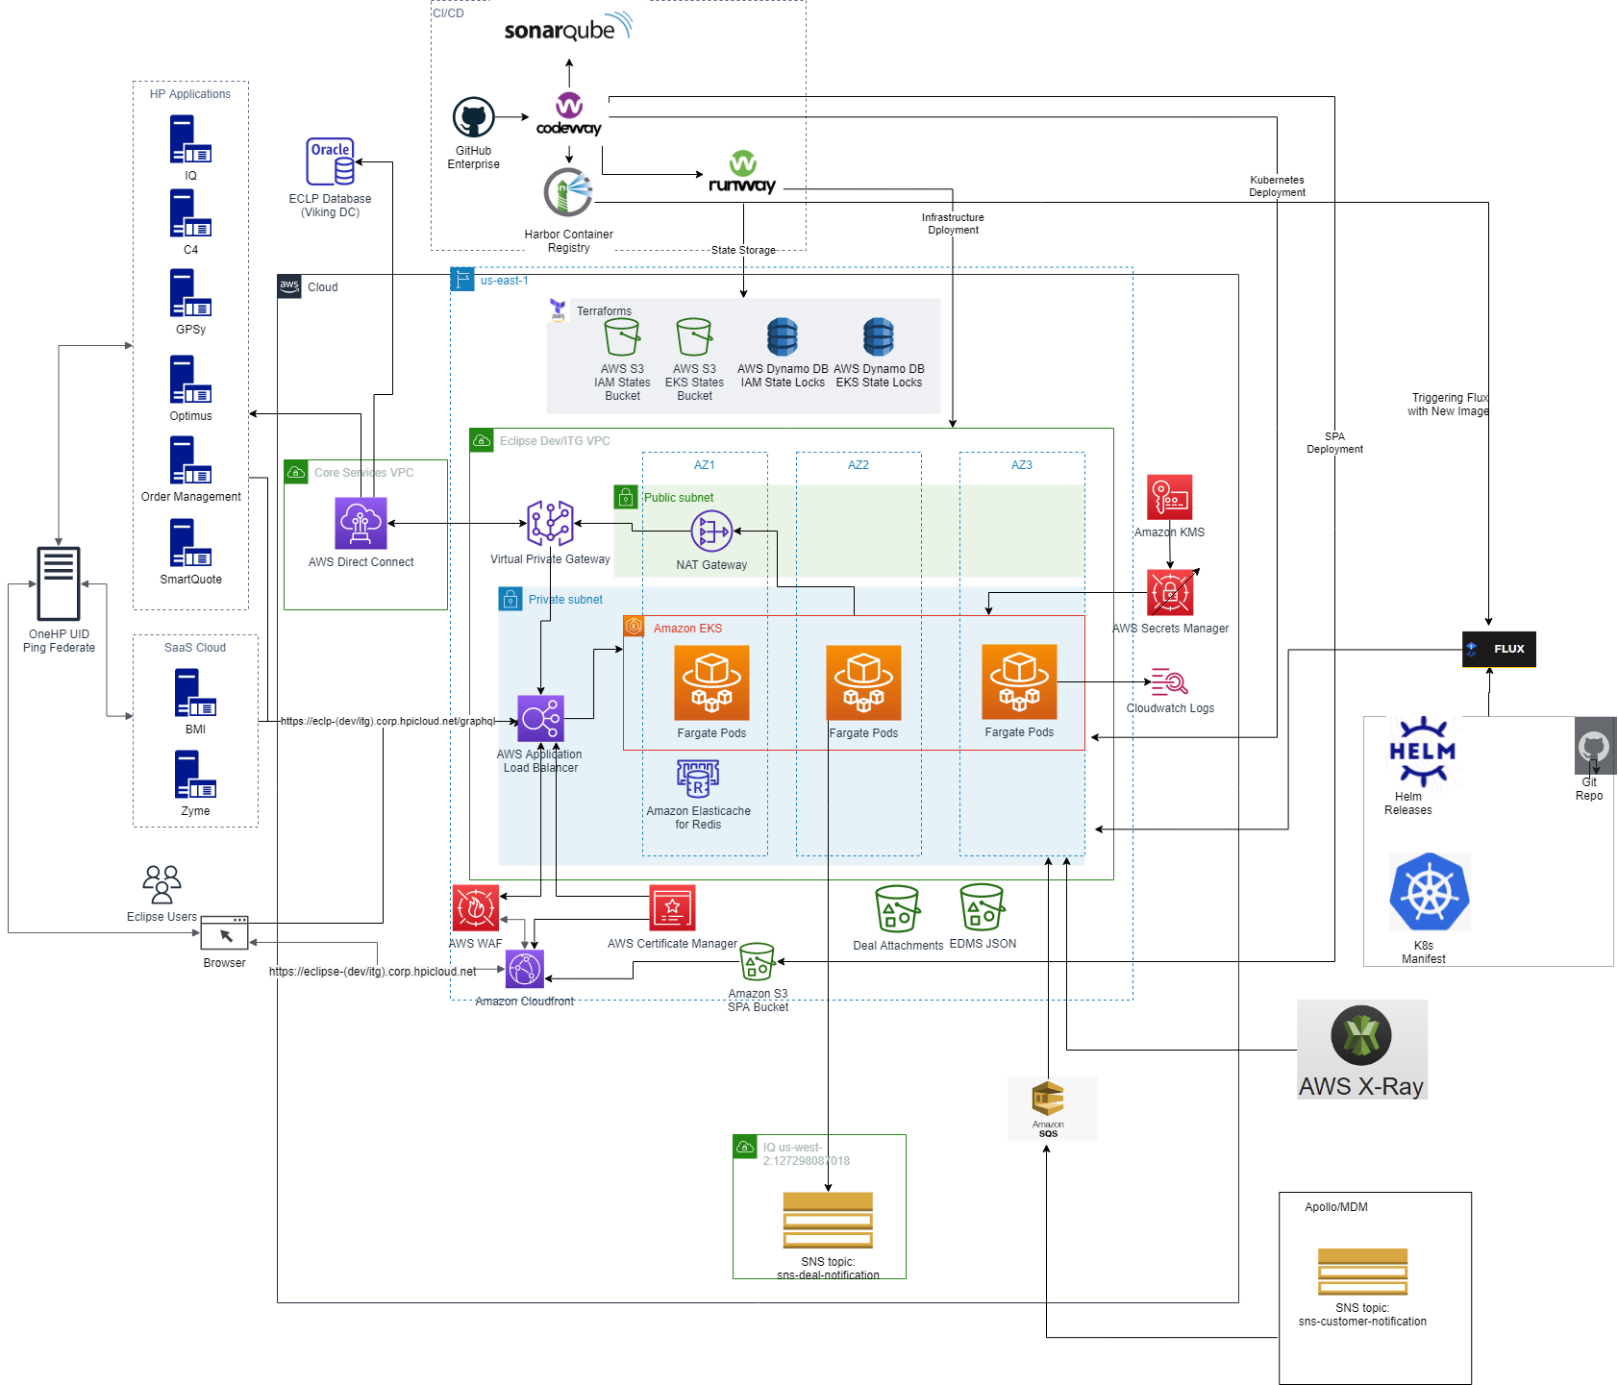
Eclipse-AWS Architecture

Slide 9
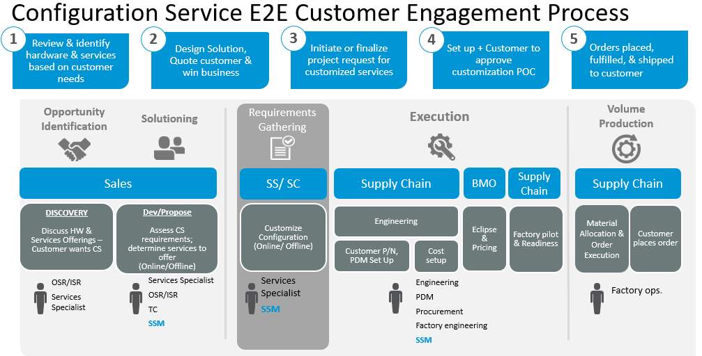

Slide 10
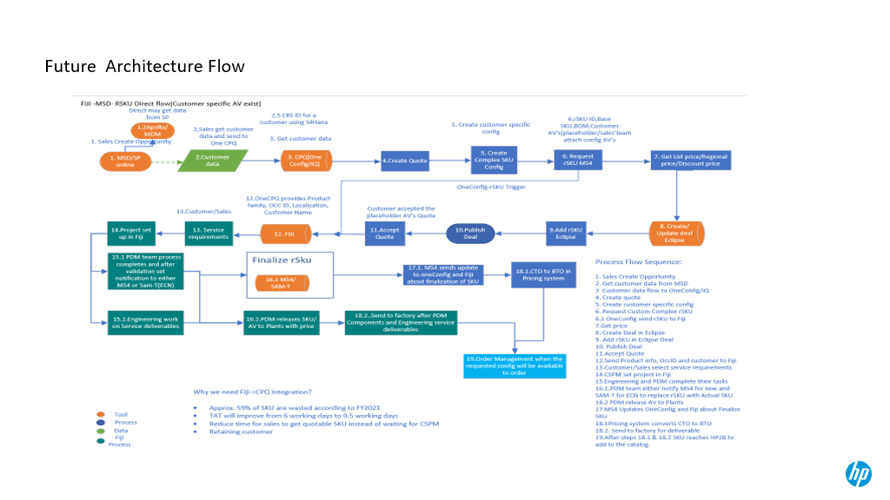
End to End Process Diagram-Fiji

Slide 11
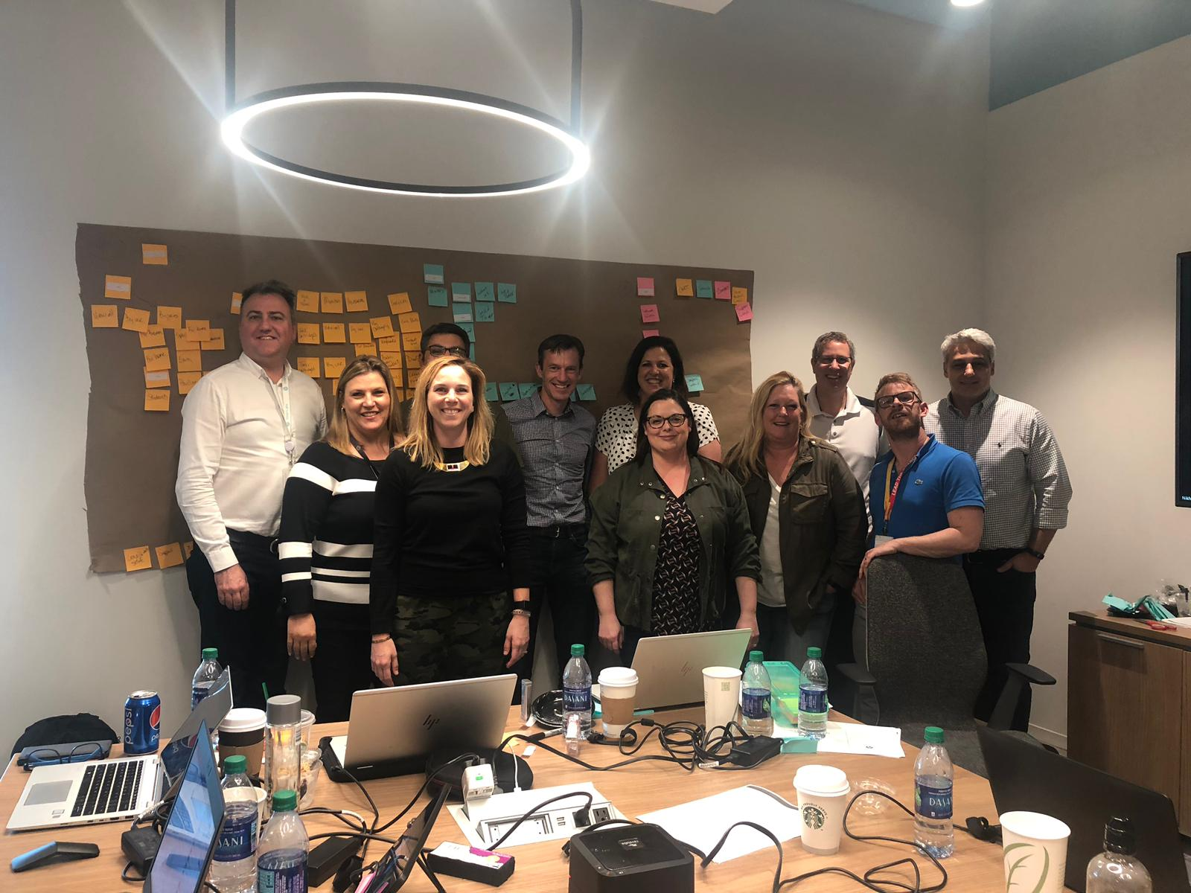
New Global Navigation - Executive Summary
Re-built in AEM
~ 5 x faster to load than existing nav
Baseline < 0.5 seconds | Load (2.3Mn users) < 1 second
More direct links in to .com, Store, Support
3 x more direct links to store
$ 3M / q projected incremental direct revenue (US)
Test was conducted under pre-covid conditions
11% higher Rev per visit | 13.5% higher revenue in India test
May 2020 – under lockdown market conditions
From a product / internal BU led layout
To a user centric, task-based approach
WW x-org collaboration – Marketing, Store, Support, IT

Slide 12




HP.com Architecture
HP Network
https://www.hp.com
Web Browser
Mobile
Akamai CDN
AWS Cloud
VPC
User Interface
Auto Scaling
Public/Private Subnets and
Availability zones as needed
Media files
SPA Web App
SPA Web App
Load Balancing
S3
Product Pages
Campaign
Click Steam Analysis
EKS
Fargate
1. For Analysis we capture click. 2. Hadoop for computing like aggregation, sort data
3. Data Warehouse for reporting for Business Intelligence
SPA Web App
SPA Web App
Landing page
Global header
CloudWatch
Application Services
Auto Scaling
Data Warehouse
Amazon RDS (DXC initially)
Store Services
Header Service
Spark/Hadoop
Primary
Standby
Content management
Footer Service
Business Intelligence
SES
ElasticCache Redis
Product Services
(
ETL
Non-SQL database to keep analytical data
Code quality
Translation Service

Slide 13
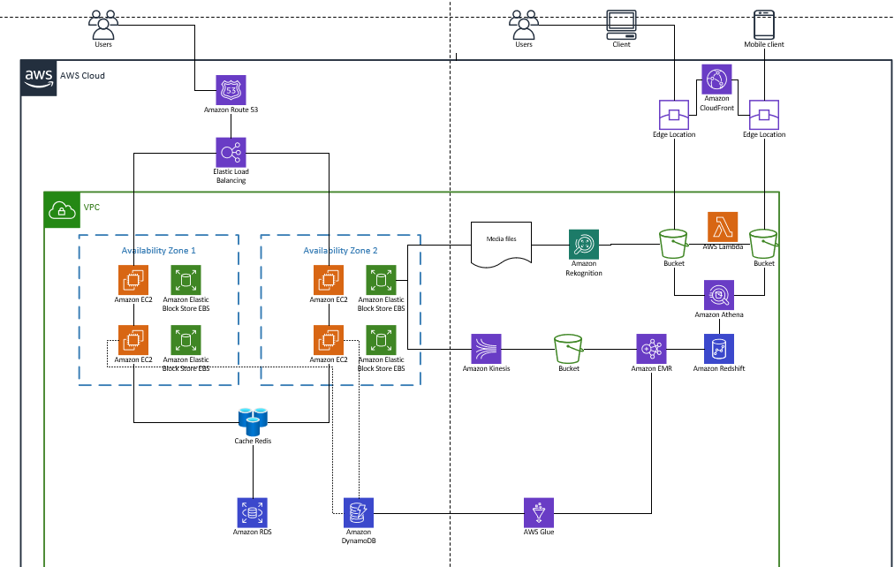
Hp.Com-Analysis Architecture

Slide 14
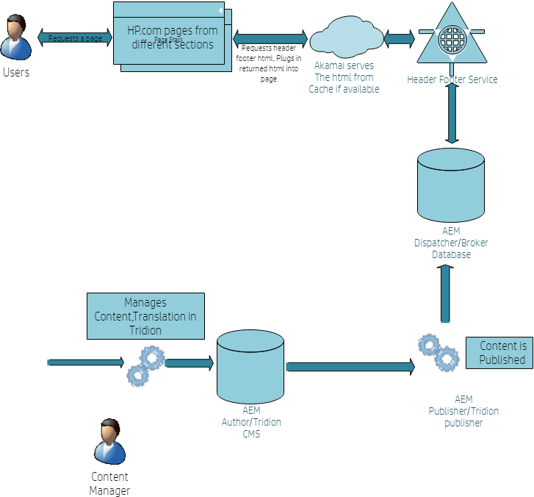
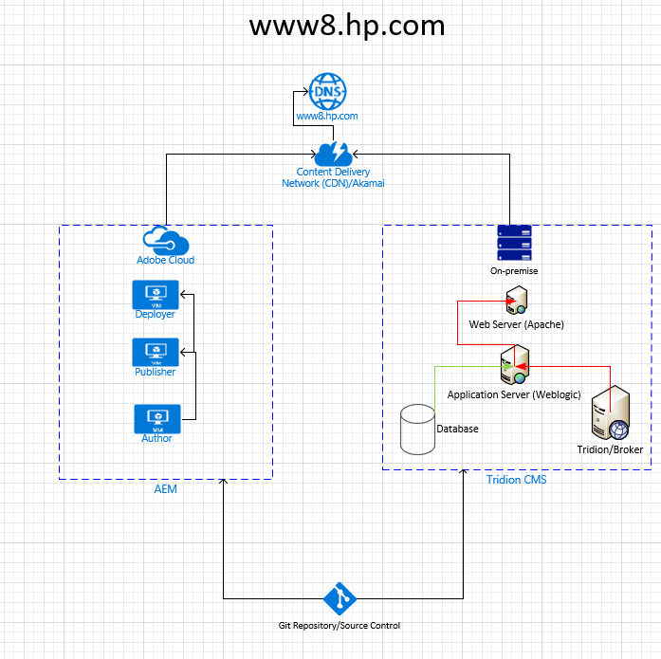
Hp.Com High level Design

